Slide 1
Chapter 4: Strain Energy
Nirmal Baran Hui
Professor
Department of Mechanical Engineering
National Institute of Technology Durgapur

Slide 2
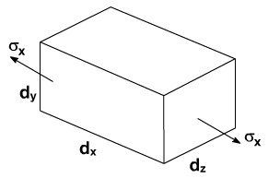

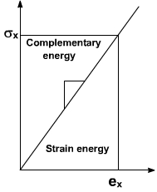
Strain Energy: Strain Energy of the member is defined as the internal work done in deforming the body by the action of externally applied forces. This energy in elastic bodies is known as elastic strain energy
Strain Energy in uniaxial Loading
Let as consider an infinitesimal element of dimensions as shown in Fig.
Let the element be subjected to normal stress σ_{x}.
The forces acting on the face of this element is σ_{x}. dy. dz
where dy dz = Area of the element due to the application of forces, the element deforms to an amount = ε_{x} dx
ε_{x} = strain in the material in x ? direction
the force that acts on the element increases linearly from zero until it attains its full value
Hence average force on the element is equal to ½ σ_{x} . dy. dz.
∴ Therefore the work done by the above force
= average force x deformed length = ½ σ_{x}. dydz . ∈_{x} . dx

Slide 3
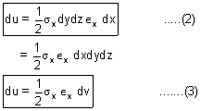
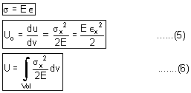

For a perfectly elastic body the above work done is the internal strain energy du.
From Hook's Law for elastic bodies, it may be recalled that
where dv = dxdydz = Volume of the element
By rearranging the above equation we can write
The equation (4) represents the strain energy in elastic body per unit volume of the material its strain energy density ‘U_{o}'.

Slide 4
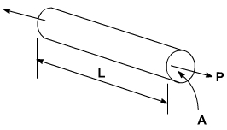
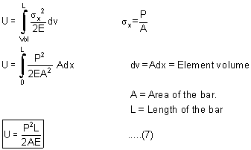
In the case of a rod of uniform cross section subjected at its ends an equal and opposite forces of magnitude P

Slide 5
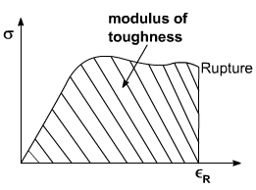
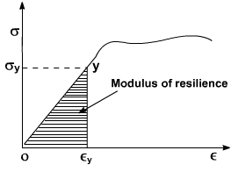
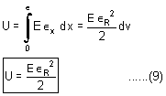

Modulus of resilience
Modulus of Toughness
Suppose ‘σ_{x}’ in strain energy equation is put equal to σ_{y} i.e. the stress at proportional limit or yield point. The resulting strain energy gives an index of the materials ability to store or absorb energy without permanent deformation
Suppose ‘∈' [strain] in strain energy expression is replaced by ∈_{R} strain at rupture, the resulting strain energy density is called modulus of toughness
From the stress-strain diagram, the area under the complete curve gives the measure of modules of toughness. It is the materials.
Ability to absorb energy upto fracture. It is clear that the toughness of a material is related to its ductility as well as to its ultimate strength and that the capacity of a structure to withstand an impact Load depends upon the toughness of the material used.
The modulus of resilience is equal to the area under the straight line portion ‘OY' of the stress? strain diagram as shown in Fig and represents the energy per unit volume that the material can absorb without yielding. Hence this is used to differentiate materials for applications where energy must be absorbed by members.

Slide 6
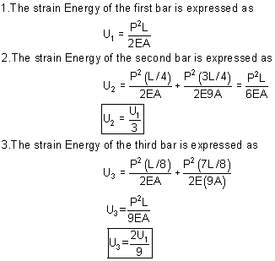
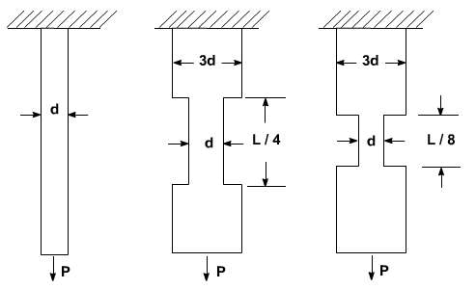
Example 1: Three round bars having the same length ‘L' but different shapes are shown in fig below. The first bar has a diameter ‘d' over its entire length, the second had this diameter over one-fourth of its length, and the third has this diameter over one eighth of its length. All three bars are subjected to the same load P. Compare the amounts of strain energy stored in the bars, assuming the linear elastic behavior.
From the above results it may be observed that the strain energy decreases as the volume of the bar increases.

Slide 7
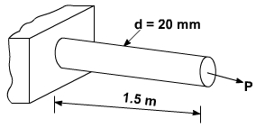
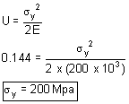

Example 2: Suppose a rod AB must acquire an elastic strain energy of 13.6 N.m using E = 200 GPa. Determine the required yield strength of steel. If the factor of safety w.r.t. permanent deformation is equal to 5.
Solution : Factor of safety = 5
Therefore, the strain energy of the rod should be
U = 5 [13.6] = 68 N.m
Strain Energy density = U/V
The volume of the rod is
Yield Strength : As we know that the modulus of resilience is equal to the strain energy density when maximum stress is equal to σ_{x} .
It is important to note that, since energy loads are not linearly related to the stress they produce, factor of safety associated with energy loads should be applied to the energy loads and not to the stresses

Slide 8
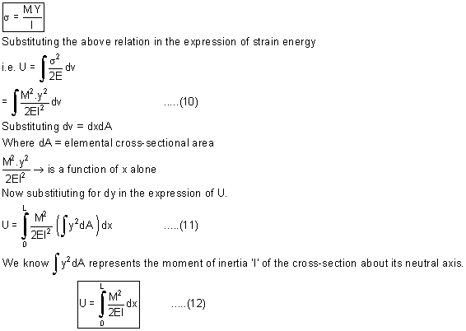
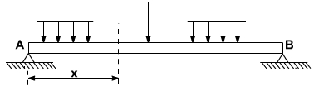
Strain Energy in Bending
Consider a beam AB subjected to a given loading as shown in figure.
Let M = The value of bending Moment at a distance x from end A.
From the simple bending theory, the normal stress due to bending alone is expressed as.

Slide 9
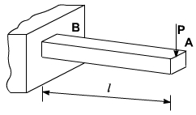
Example 1: Determine the strain energy of a prismatic cantilever beam as shown in the figure by taking into account only the effect of the normal stresses.
Solution : The bending moment at a distance x from end A is defined as
Substituting the above value of M in the expression of strain energy
we may write

Slide 10
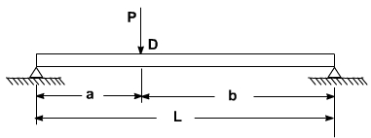


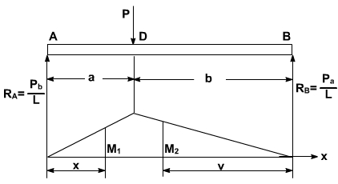


Problem 2:
Determine the expression for strain energy of the prismatic beam AB for the loading as shown in figure below. Take into account only the effect of normal stresses due to bending.
Evaluate the strain energy for the following values of the beam
P = 208 KN ; L = 3.6 m = 3600 mm; A = 0.9 m = 90mm ; b = 2.7m = 2700 mm ; E = 200 GPa ; I = 104 x 10⁸ mm⁴
For Portion AD of the beam, the bending moment is
For Portion DB, the bending moment at a distance v from end B is

Slide 11
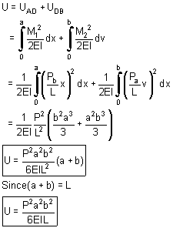

Strain Energy: Since strain energy is a scalar quantity, we may add the strain energy of portion AD to that of DB to obtain the total strain energy of the beam.
b. Substituting the values of P, a, b, E, I, and L in the expression.

Slide 12
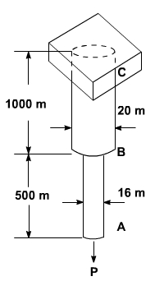
Problem 3: Determine the modulus of resilience for each of the following materials.
Stainless steel . E = 190 GPa ; σ_{y} = 260MPa
Malleable cast Iron E = 165GPa ; σ_{y} = 230MPa
Titanium E = 115GPa ; σ_{y} = 830MPa
Magnesium E = 45GPa ; σ_{y} = 200MPa
Problem 4: For the given Loading arrangement on the rod ABC determine
(a). The strain energy of the steel rod ABC when P = 40 KN.
(b). The corresponding strain energy density in portions AB and BC of the rod.

Slide 13
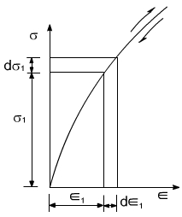
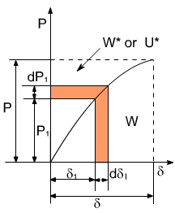

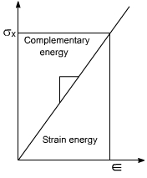

Complementary Strain Energy
Consider the stress strain diagram as shown below. The area enclosed by the inclined line and the vertical axis is called the complementary strain energy. For a linearly elastic materials the complementary strain energy and elastic strain energy are the same.
Let us consider elastic non linear prismatic bar subjected to an axial load. The resulting stress strain plot is as shown.
The new term complementary work is defined as follows
So In geometric sense the work “W*” is the complement of the work ‘W' because it completes rectangle as shown in the above figure
Sometimes the complementary energy is also called the stress energy. Complementary Energy is expressed in terms of the load and that the strain energy is expressed in terms of the displacement.

Slide 14
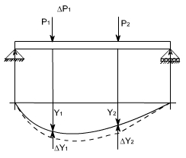


Castigliano's Theorem
Strain energy techniques are frequently used to analyze the deflection of beam and structures. Castigliano's theorem were developed by the Italian engineer Alberto Castigliano in the year 1873, these theorems are applicable to any structure for which the force deformation relations are linear
Consider a loaded beam as shown in figure
Let the two Loads P₁ and P₂ produce deflections Y₁ and Y₂ respectively strain energy in the beam is equal to the work done by the forces.
Let the Load P₁ be increased by an amount ΔP₁.
Let ΔP₁ and ΔP₂ be the corresponding changes in deflection due to change in load to ΔP₁.
Now the increase in strain energy
Suppose the increment in load is applied first followed by P₁ and P₂ then the resulting strain energy is

Slide 15




Suppose the increment in load is applied first followed by P₁ and P₂ then the resulting strain energy is
Since the resultant strain energy is independent of order loading,
Combing equation 1, 2 and 3. One can obtain
or upon taking the limit as ΔP₁ approaches zero
[Partial derivative are used because the strain energy is a function of both P₁ and P₂ ]
For a general case there may be number of loads, therefore, the equation (6) can be written as
The above equation is castigation's theorem:

Slide 16

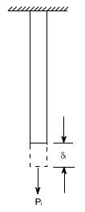


The statement of this theorem
If the strain energy of a linearly elastic structure is expressed in terms of the system of external loads. The partial derivative of strain energy with respect to a concentrated external load is the deflection of the structure at the point of application and in the direction of that load.
In a similar fashion, Castigliano's theorem can also be valid for applied moments and resulting rotations of the structure
Where M_{i} = applied moment and θ_{i} = resulting rotation
Castigliano's Second Theorem
In similar fashion as discussed, suppose the displacement of the structure are changed by a small amount dδ_{i}. While all other displacements are held constant the increase in strain energy can be expressed as
Where ∂U / δ_{i} → is the rate of change of the starin energy w.r.t δ_{i}.
It may be seen that, when the displacement δ_{i} is increased by the small amount dδ; workdone by the corresponding force only since other displacements are not changed.
The work which is equal to P_{i}dδ_{i} is equal to increase in strain energy stored in the structure
The partial derivative of strain energy w.r.t. any displacement δ_{i} is equal to the corresponding force P_{i} provided that the strain is expressed as a function of the displacements.

Slide 17
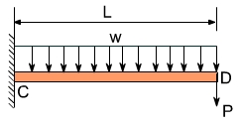




Example 1: The cantilever beam CD supports a uniformly distributed Load w. and a concentrated load P as shown in figure below. Suppose
L = 3m; w = 6KN/m ; P = 6KN and E. I = 5 MN m² determine the deflection at D
The deflection 'Y₀’ at the point D Where load ‘P' is applied is obtained from the relation
Since P is acting vertical and directed downward δ; represents a vertical deflection and is positions downward.
The bending moment M at a distance x from D
And its derivative with respect to ‘P' is

Slide 18
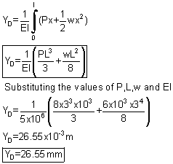

Substituting for M and ∂ M/ ∂ P into equation (1)
$$\text{If} \text{P} \text{is} \text{zero}$$

Slide 19
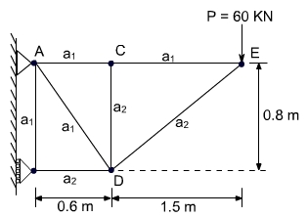
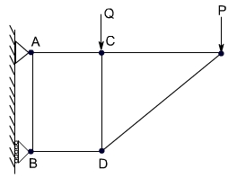

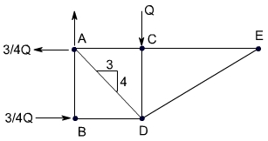
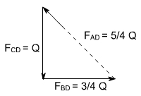
Problem 2: For the truss as shown in the figure above, Determine the vertical deflection at the joint C.
Solution: Since no vertical load is applied at Joint C. we may introduce dummy load Q. as shown below
Using castigliano's theorem and denoting by the force F_{i} in a given member i caused by the combined loading of P and Q. we have
Free body diagram : The free body diagram is as shown below
Force in Members: Considering in sequence, the equilibrium of joints E, C, B and D, we may determine the force in each member caused by load Q.
Joint E: F_{CE} = F_{DE} = 0
Joint C: F_{AC} = 0; F_{CD} = -Q
Joint B: F_{AB} = 0; F_{BD} = -3/4Q

Slide 20



The total force in each member under the combined action of Q and P is (P = 60 KN)
Member | F_{i} | δF_{i}/δQ | L_{i} , m | A_{i} , m²
AB AC AD BD CD CE DE | 0 +15P/8 +5P/4+5O/4 -21P/8-3Q/4 -Q 15P/8 -17P/8 | 0 0 5/4 -3/4 -1 0 0 | 0.8 0.6 1.0 0.6 0.8 1.5 1.7 | 5000x10⁻⁶ 5000x10⁻⁶ 5000x10⁻⁶ 1000x10⁻⁶ 1000x10⁻⁶ 500x10⁻⁶ 1000x10⁻⁶ | 0 0 3125P+3125Q 1181P+338Q +800Q 0 0
Since the load Q is not the part of loading therefore putting Q = 0
Sub-(2) in (1)

Slide 21
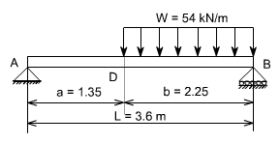
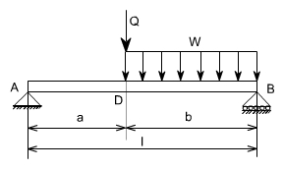
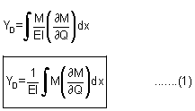
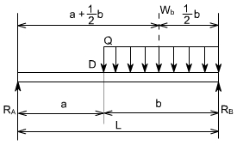

Problem 3: For the beam and loading shown, determine the deflection at point D. Take E = 200Gpa, I = 28.9x10⁶ mm⁴
Solution: Castigliano's Theorem: Since the given loading does not include a vertical load at point D, we introduce the dummy load Q as shown below. Using Castigliano's Theorem and noting that E.I is constant, we write.
Reactions

Slide 22

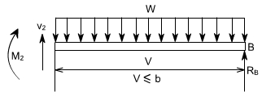
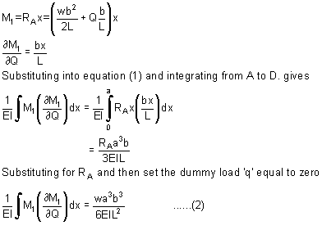
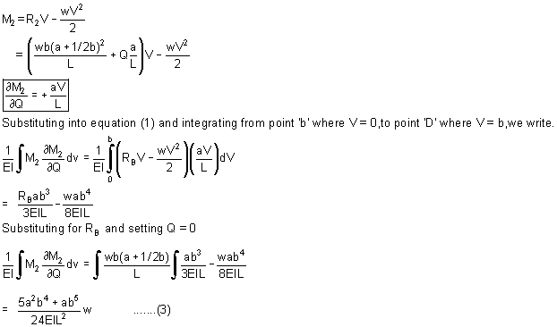
Portion AD of Beam :
Portion DB of Beam : From Using the F.B.D shown below we find the bending moment at a distance V from end B is

Slide 23
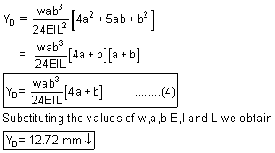
Deflection at point D:
Recalling eq (1), (2) and (3) we have

